Slide 1
Prachi Sharma
Prithviraj Naidu
Sarah Fernandes
Vikita Nayak

Slide 2
Company Overview

Slide 3
History & Timeline
Oct 2002
Apr 2007
Feb 2008
Jul 2008
Roku as a LLC, Anthony Wood
Anthony Wood, Vice President of Netflix
New Roku Company to make players for Netflix
Company HQ moved Saratoga, CA
2016
2015
2009
Oct 2008
Partnered with Magna for targeted advertising
Sub-leased buildings in Los Gatos, CA
2nd round of funding of about $8.4 million
1st round of funding from Menlo Ventures
Sep 2017
Nov 2017
Dec 2017
IPO and Stock Trading on NASDAQ
Self serving advertising product launched
Acquired Danish based smart speakers startup, Dynastrom

Slide 4

Vision & Mission
Roku’s mission is to be the TV streaming platform that connects the entire TV ecosystem. They connect consumers with the content they love. They help content publishers find their audience and make money.

Slide 5
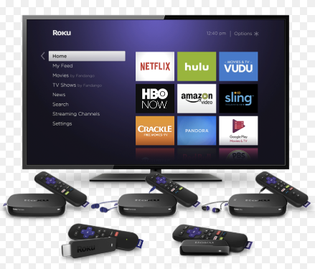
Products & Services
Roku Streaming Player
Roku TV
Roku Express
Roku Express+
Roku Streaming Stick
Roku Streaming Stick+
Roku Ultra
Miscellaneous Accessories

Slide 6
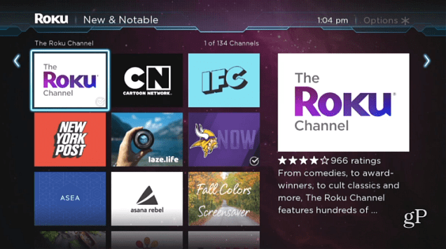
Products & Services
Roku Channel
Licensing
Advertising

Slide 7
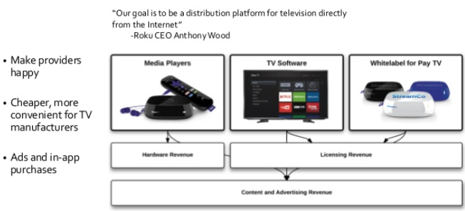
Business Model
Media Players
TV Software
Whitelabel for Pay TV
Hardware Revenue
Licensing Revenue
Content & Advertising Revenue

Slide 8
Industry Overview

Slide 9
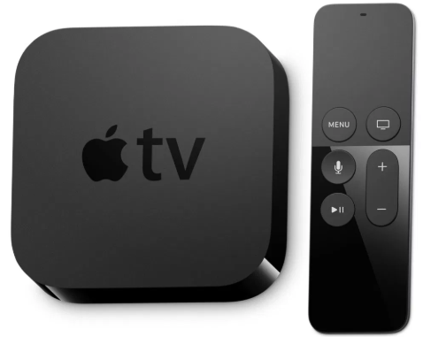
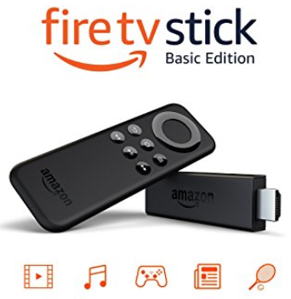
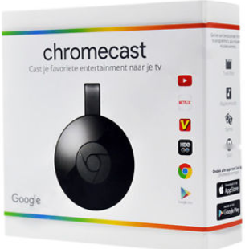


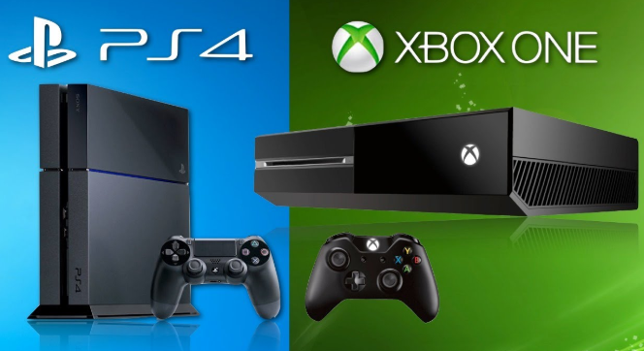
Competitors’ Analysis

Slide 10
External Analysis

Slide 11
Porters’ Five Force Analysis
Industry is growing
Promising in terms of profit
Expensive initial startup cost
Fierce Competition
Brand loyalty
Potential Threat of New Entrants
Low
Bargaining Power of Suppliers
Moderate to High
Competitive
Rivalry
Moderate to high
Bargaining Power of Buyers
Low
Content providers, Cable networks
Many players on OTT
Switching cost is low
Cost of switching is low
Customer’s can’t regulate prices or bargain
Threat of Substitutes
Low
Gaming systems, Laptops
Smart TVs that support OTT streaming

Slide 12
Role of Complement → High
ISPs
Content Providers
Media Partners
Retailers & Distributors
Hardware manufacturer

Slide 13
Five Force Analysis Summary
Fierce competition among big players like Google, Amazon, Apple with slightly different subscription model.
Given the dependency of the OTT players on their suppliers like content providers and hardware manufacturers it is very essential for them to expand partnership with all of them.
The companies should come up with the different subscription models to suffice the varying demands of their customers.

Slide 14
Internal Analysis

Slide 15
Swot Analysis
Strengths
· Accessible
· User Friendly
· Brand recognition of Affiliates
· Inexpensive
· No Monthly Fees
· Appeals to all ages
· Convenient
Weaknesses
· Brand Recognition of Roku
· Lack of promotion
· Education
· Lack of Specific Brand Image
Opportunities
· Lack of Direct Competitors
· Consumer Lifestyle
· Growing Popularity of Online Media
Threats
· Low Barriers to Entry
· Possible Substitutes like Gaming Systems, Laptops and Smart TVs
· Dependence on the success of other channels (Netflix, HBO GO, Amazon Prime, etc)

Slide 16
Financial Analysis

Slide 17
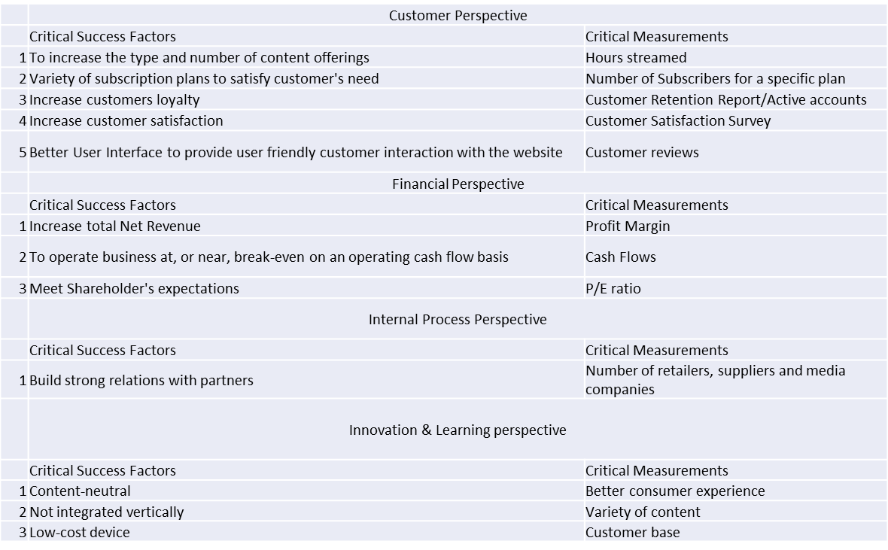
Balance Scorecard

Slide 18
Revenue Sources
Roku differentiates its sources of revenue into two segments
Player: Player revenue is generated from the sale of streaming players through consumer retail distribution channels
Platform: Platform Revenue is generated from advertising sales, subscription and transaction revenue share, sales of branded channel buttons on remote controls and licensing arrangements with TV brands and service operators.

Slide 19

Financial Summary
Key Performance Metrics to evaluate the business performance, devise financial forecasts and strategic decisions
Gross Profit
Active Accounts
Hours Streamed
Average Revenue per User

Slide 20
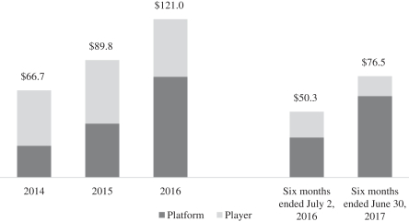
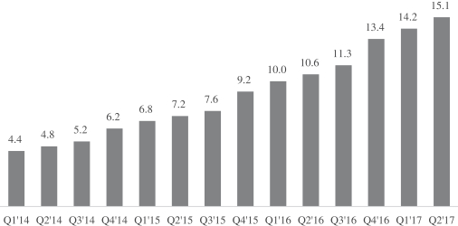
Key Metrics Analysis
Gross Profit
Active Accounts
Units in $ million
Units in Million

Slide 21
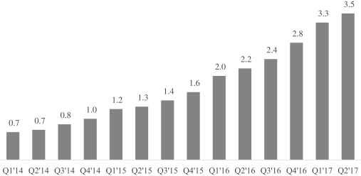
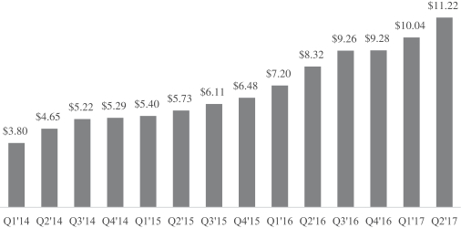
Key Metrics Analysis
Hours Streamed
Average Revenue per User
Units in Billion hours
Units in $

Slide 22

Comparison of Financials (YEARS 2017-2016)
Net Revenue
Roku reported a total net revenue of $512.763 million in FY17.
Player: Contributed to $287.407 million. Player revenue decreased by 2% as compared to the year 2016. There was a $1.3 million increase in revenues from licensing arrangements.
Platform: Contributed to $225.35 million, a 115% increase from 2016

Slide 23
S - Curve

Slide 24
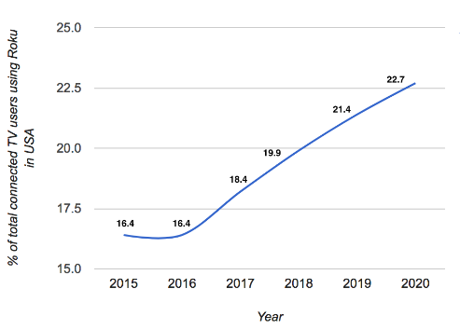
S - Curve
https://www.emarketer.com/Chart/Select-US-Connected-TV-Users-by-Device-2015-2020-of-total-connected-TV-users/199322

Slide 25
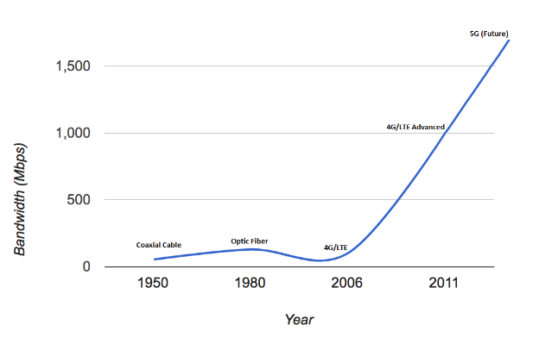
S - Curve

Slide 26
Multidimensional Model

Slide 27
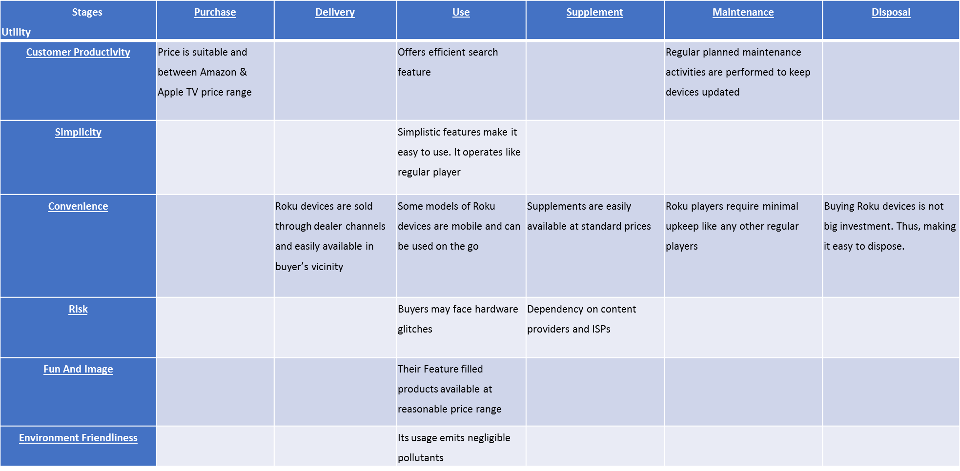
Multidimensional Model

Slide 28
Multidimensional Model
Technology Standalone Value:
Roku players provides consumers with instant, on-the-go access to their favorite content and watch countless channels through “pick and-choose” model.
Roku player hardware includes implanted software with indefinite upgrades on the when-and-if-available basis.
Ease of Use
Picking shows is mindlessly easy, its on-screen display is both simple to view and to navigate
Users can smoothly search for movies and TV shows across Netflix, Crackle, Amazon and YouTube
Roku’s wide-ranging and unbiased worldwide search and discovery features make Roku player of masses
Value to Customer
Roku offers wide range of product and services for every consumer segment
From new smart TV users to experienced users, it has products designed for all customer’s need within reasonable prices

Slide 29
Multidimensional Model
Network Externality Value:
With TV streaming, not just consumer’s experience is enhanced but also, they get more entertainment selections.
The content quality also improves as more and more users are on boarded on the platform.
Size of Installed Base-
The Roku handles more than 19.3 million active accounts and users streamed 14.8 billion hours on the Roku platform during 2017.
Availability of Complementary Goods-
Roku’s platform enables content providers to stream their content on a widely used platform.

Slide 30
Value Chain Analysis

Slide 31






Value Chain Analysis
Inbound Logistics
Content from Paramount and Warner Bros
Television Service Providers & Advertisers
Weakness
Dependency on providers for content
Operations
Licensing rights of content
Keeping subscribers happy
License technology and proprietary
Weakness
Need to maintain large subscriber base
Outbound Logistics
Various ISPs and Roku devices
Weakness
Dependency on ISPs and hardware manufacturers
Marketing
Use hardware to grow its audience
Monetize through advertising
Create integrated & insight based advertising
Weakness
Roku brand is not widely recognized
Services
Convenience of viewership
Manufacture variety of products

Slide 32



Support Activities
This includes departments like management, finance, legal, etc., which are required to keep the company’s stores operational
INFRASTRUCTURE
Employees, particularly engineers and other product developers, are in high demand, and Roku devotes significant resources to identifying, hiring, training, successfully integrating and retaining these employees
HUMAN RESOURCE MANAGEMENT
Continue R&D in the streaming market
As the technological infrastructure for Internet access continues to improve and evolve, consumers will be presented with more opportunities to access video, music and games on-demand with interactive capabilities
TECHNOLOGY DEVELOPMENT

Slide 33
Strategic Implementation & Risk Assessment

Slide 34

Strategic Implementation
Advertising:
Roku is known for its set-top accessories
Roku’s advertising business witnessed overwhelming growth
The platform revenue including ads saw a growth of 137 percent year on year with two-thirds of this platform revenue coming from ads, while the hardware sales grew 4 percent as per recent earnings call.
Advertising constitutes two-thirds of Roku’s platform business.
Roku has been aggressively expanding its reach in the advertising segment.
As per Nielsen Digital Ad Ratings, Roku is the first OTT TV platform to offer audience guarantees, closing the gap between OTT TV and traditional TV.

Slide 35
Strategic Implementation
New Roku Accounts
During the quarter just ended, Roku saw more new user accounts being created through its licensed TVs than its own gadgets.
As per stats, Roku now has 17.7 million active accounts, 48 percent increase year on year.
Hardware Prices
Roku has been playing its part in new user additions by lowering its device prices for new users.
The average price of its hardware dropped 23 percent from the same time last year, while it boosted sales by 35 percent
As hardware prices keep diminishing, Roku can make the most of the huge user base by selling advertising around them far down the line.

Slide 36

Strategic Implementation
Marketing
Being a lesser brand compared to its giant Silicon Valley rivals, Roku has done well to keep its marketing expenses down
It instead relies on strategic placements that its branded TVs afford in the electronics aisles and online listings, while cashing in on its reputation earned over the years in the segment.

Slide 37
Risk Assessment
The TV streaming industry is highly competitive with many large tech companies, TV brands and service operators actively focusing on it. If Roku fails to compete with these companies it will be difficult for them to attract users and business may be harmed.
Failing to maintain relationships with content publishers is one of the very important risks that Roku Inc faces.
Roku does not have manufacturing capabilities and primarily depend upon a single contract manufacturer; their operations could be disrupted if Roku encounters problems with the contract manufacturer.
If Roku’s advertisers or advertising agencies do not pay or dispute their invoice, then Roku’s business may be harmed.

Slide 38
Recommendation
Continue to expand their portfolio by fostering long-term relationship with content suppliers
Establish more sustainable distribution methods
Enhance TV watching experience by making it more interactive and convenient unlike static channels.
They have huge opportunity in content distribution and advertising, hence they should invest more in that.
Moving forward if their profit margin increases significantly they should invest in marketing to strengthen its brand following.

Slide 39
Thank You!

Slide 40
Questions?

